Slide 1




Updates on FitBenchmarking​
Anders Markvardsen and
Patrick Odagiu via separate recorded PowerPoint
24th May 2019

Slide 2
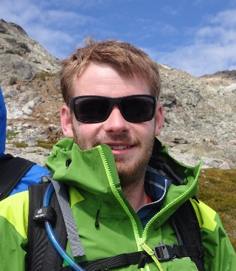
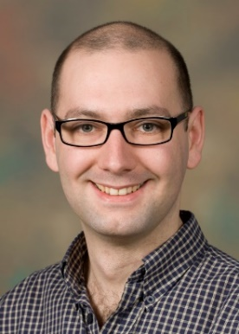
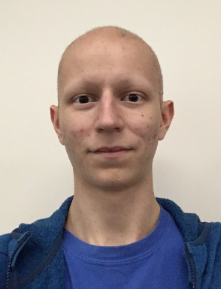
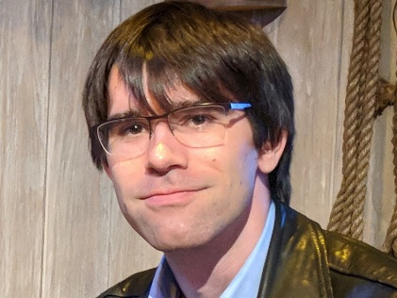
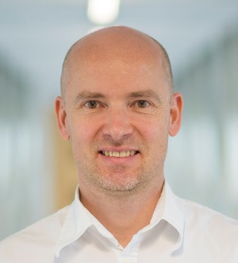
People now
Michael Wathen Tyrone Rees
(STFC SCD MathComp group)
Patrick Odagiu
(Manchester University)
Anthony Lim Anders Markvardsen
(STFC ISIS SciSoft group)

Slide 3
Past contributors
Members of the Mantid team at ISIS including: Federico Montesino Pouzols and Roman Tolchenov as members of the ISIS Mantid team
Nick Gould and Jennifer Scott, members of the SCD MathComp group

Slide 4
Swap to Patrick

Slide 5
Opportunities for getting involved
As the SasView team (joint summer student starting 24th June)
Contribute to the framework

Slide 6
SasView example
Benefit to SasView:
How Bumps local minimizers performance/reliability compare against common SasView fitting problems
How about compare against other local minimization implementations

Slide 7
SasView example
Benefits to FitBenchmarking:
Include Bumps as install option
Include additional set of benchmarking problem

Slide 8
Work items (and status)
Near future (before Sep)
Make it easier to add new software/libraries containing minimizer
…
Medium term
Support ‘exact’ software minimizer comparisons
…
Potentially longer term
Benchmark other classes of ‘minimizers’, including global minimizers, Bayesian optimizers
…

Slide 9
https://github.com/fitbenchmarking/fitbenchmarking
Thanks
And don’t hesitate to contact us, including via fitbenchmarking.supp@gmail.com

Slide 10
Vision
Deliver a tool to benchmark the performance of different minimizers, which will allow scientists to choose objectively which minimizer performs best on the types of problems they are interested in.

